Slide 1
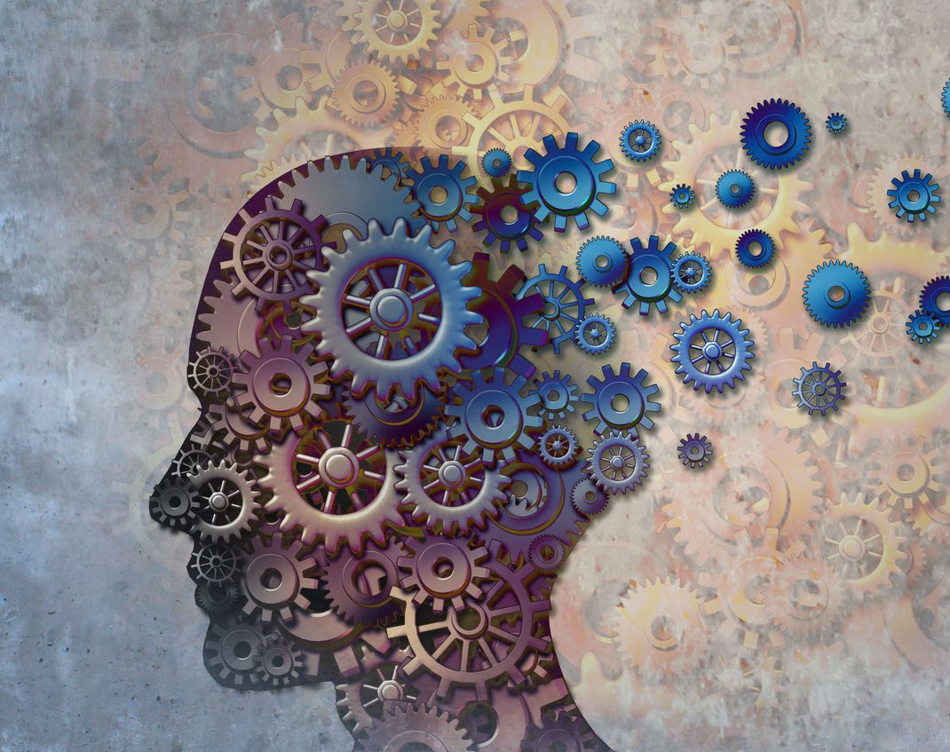

Predicting Alzheimer’s Disease Using Brain MRI
Feras Altwal
Capstone Project
DSIR-824

Slide 2
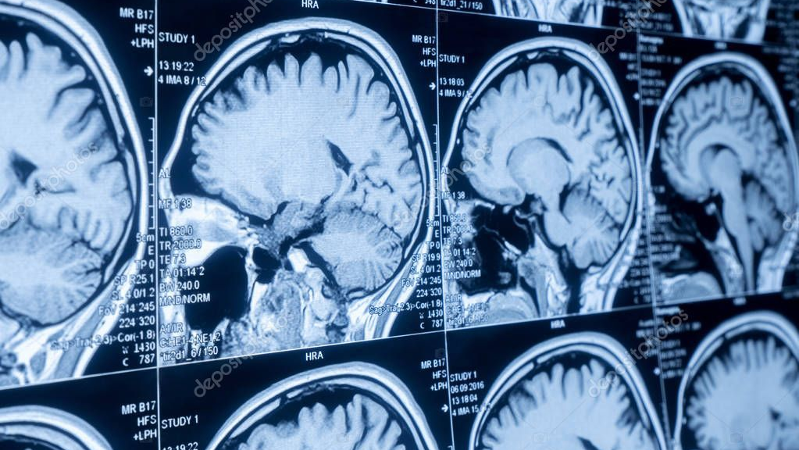
Problem Statement
Can we detect Alzheimer’s disease using brain MRI?

Slide 3
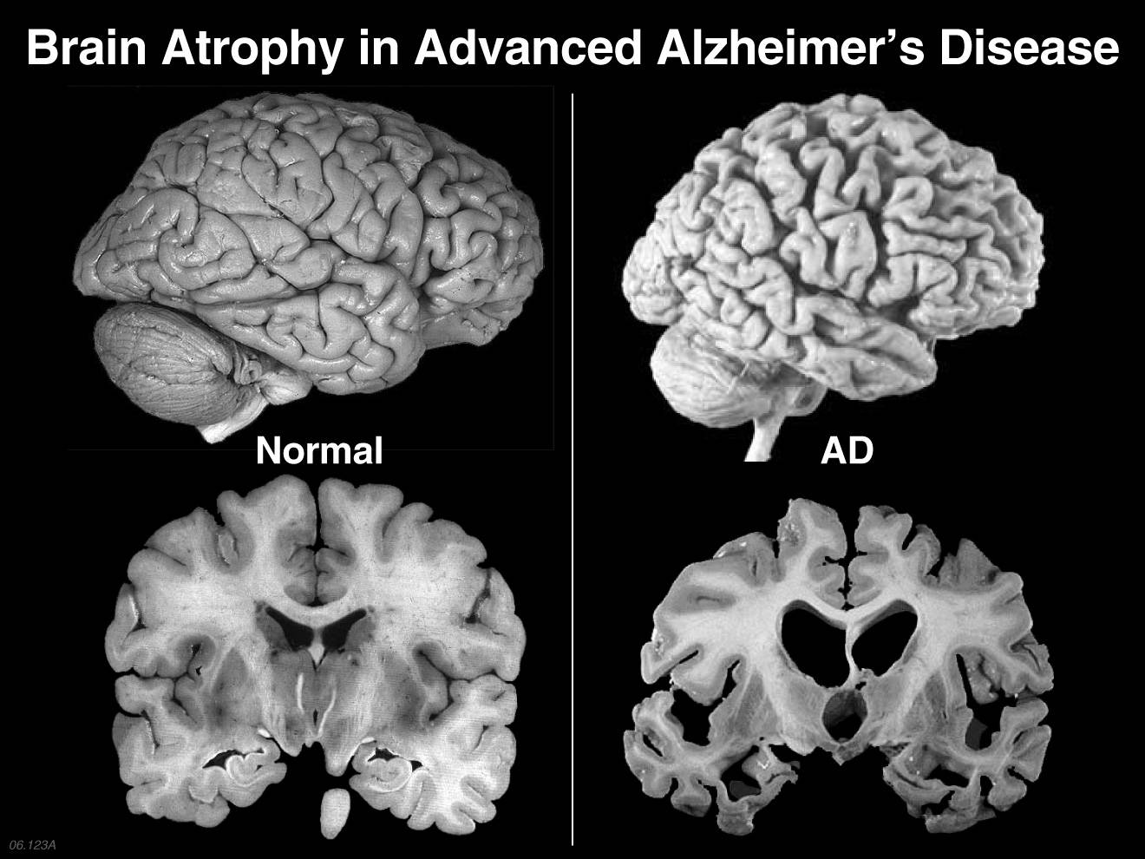
Alzheimer’s Disease (AD)
Progressive neurodegenerative disease
Leads to dementia, language, reasoning, social behavior
Affects 44 million around the world, 5.5 million in the US

Slide 4
Project Pipeline
Data collection
Image
pre-processing
Data visualization
Modeling
Interactive Model

Slide 5
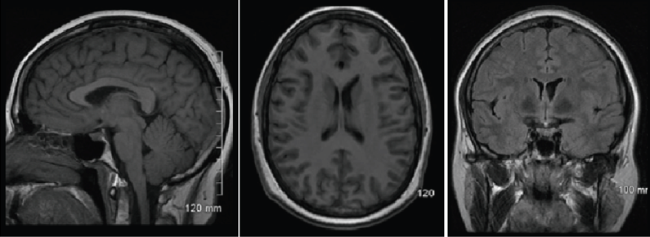
ADNI Dataset
Alzheimer's Disease Neuroimaging Initiative (ADNI)
Well-maintained collections of brain images (MRI, PET scans)

Slide 6
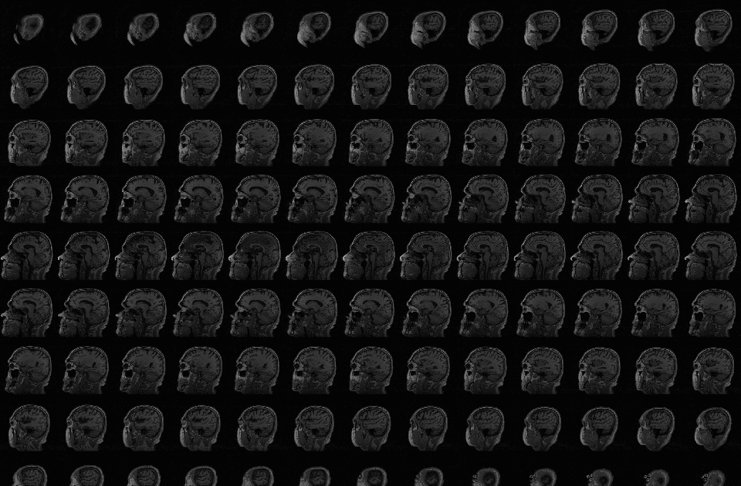
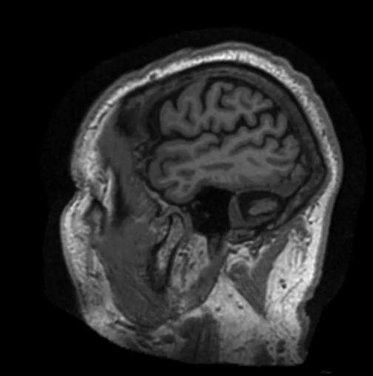
Dataset
T1-MRI images provided as NIFTI files
NIFTI contains 160-170 images/ patient
Patients:
AD: 117 subjects (~10K images)
CN: 137 subjects (~12K images)

Slide 7
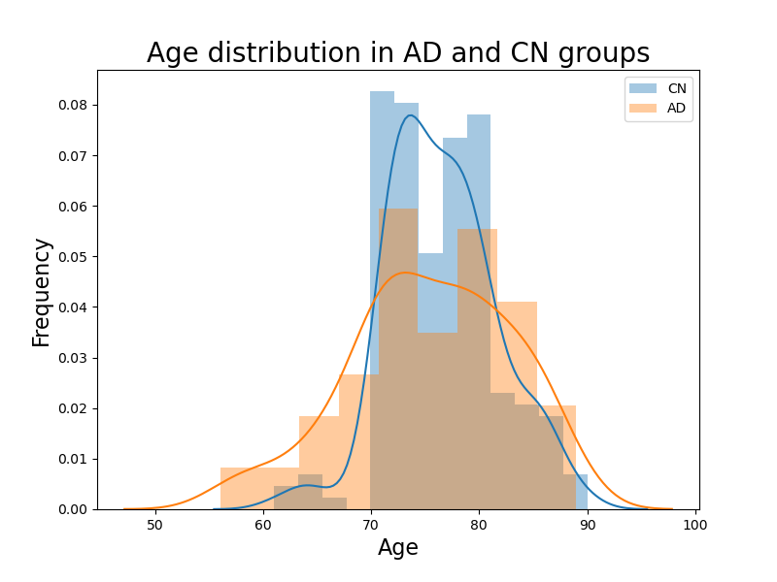
EDA

Slide 8
Image Processing
image Extraction
Skull stripping
resizing
Grayscale

Slide 9
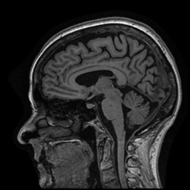
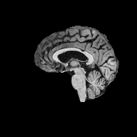
Image Processing
Skull stripping using a modified nii2png library

Slide 10
Modeling
Simple m

Slide 11
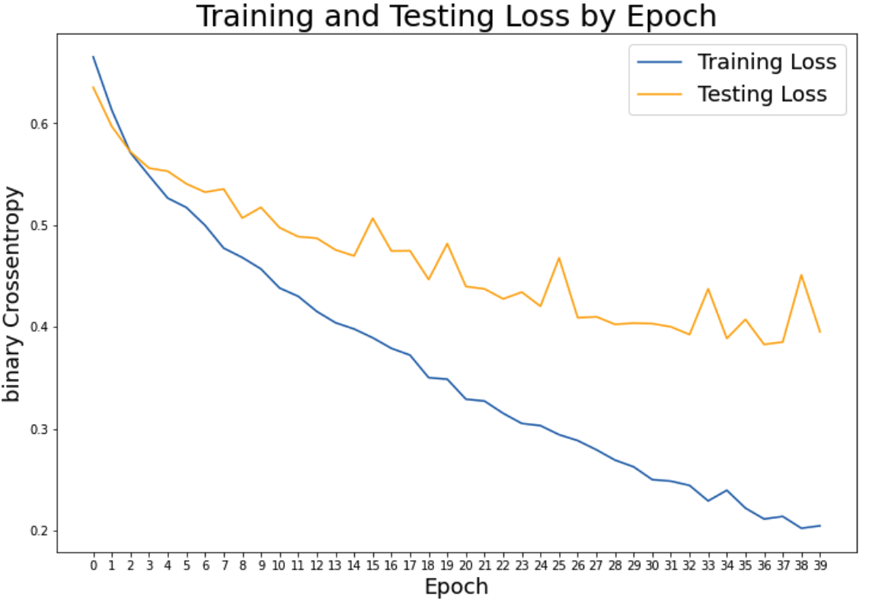
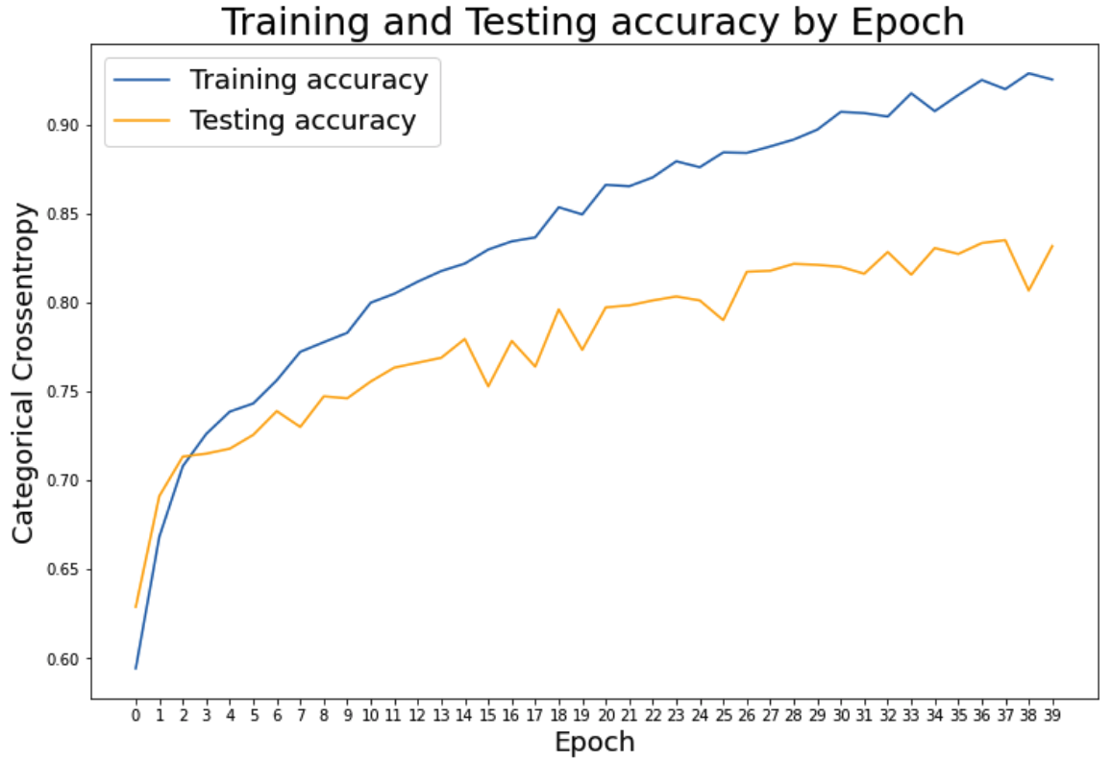
Loss by epoch
accuracy by epoch

Slide 12
Interactive Model
http://192.168.1.213:8503
AD detection demo

Slide 13
Future Directions

